Slide 1

2025 Third Quarter
Investor Conference
Security Code: 2420

Slide 2
Disclaimer
No representation or warranty express or implied, is or will be made in or in relation to, and no responsibility or liability is or will be accepted by the Company as to, the accuracy or completeness of the information and any liability therefore is hereby expressly disclaimed.

Slide 3
Operating performance for 2025 Q1~Q3
Unit: NTD Thousand | 2025 Q1~Q3 |  |  | 2024 Q1~Q2 |  |  | YoY
 | AMT. | % |  | AMT. | % |  | %
Sales revenue | 1,653,191 | 100.00% |  | 1,705,394 | 100.00% |  | -3.06%
Gross profit from operation | 741,331 | 44.84% |  | 812,258 | 47.63% |  | -8.73%
Operating expenses | 292,141 | 17.67% |  | 309,181 | 18.13% |  | -5.51%
Net operating income | 449,190 | 27.17% |  | 503,077 | 29.50% |  | -10.71%
Non-operating income and expenses | 77,086 | 4.66% |  | 145,358 | 8.52% |  | -46.97%
Continuing operating income before tax | 526,276 | 31.83% |  | 648,435 | 38.02% |  | -18.84%
Continuing operating income after tax | 414,991 | 25.10% |  | 520,539 | 30.52% |  | -20.28%
Profit attributable to owners of the company | 414,693 | 25.08% |  | 520,117 | 30.50% |  | -20.27%
EPS (Dollars) | 2.72 |  |  | 3.41

Slide 4
Operating performance for 2025 Q3
Unit: NTD Thousand | 2025 Q3 |  |  | 2025 Q2 |  |  | QoQ |  | 2024 Q3 |  |  | QoQ
 | AMT. | % |  | AMT. | % |  | % |  | AMT. | % |  | %
Sales revenue | 528,419 | 100.00% |  | 580,948 | 100.00% |  | -9.04% |  | 583,107 | 100.00% |  | -9.38%
Gross profit from operation | 233,919 | 44.27% |  | 266,845 | 45.93% |  | -12.34% |  | 280,645 | 48.13% |  | -16.65%
Operating expenses | 100,372 | 18.99% |  | 95,247 | 16.40% |  | 5.38% |  | 96,770 | 16.60% |  | 3.72%
Net operating income | 133,547 | 25.27% |  | 171,598 | 29.54% |  | -22.17% |  | 183,875 | 31.53% |  | -27.37%
Non-operating income and expenses | 53,779 | 10.18% |  | (21,031) | -3.62% |  | -355.71% |  | 19,866 | 3.41% |  | 170.71%
Continuing operating income before tax | 187,326 | 35.45% |  | 150,567 | 25.92% |  | 24.41% |  | 203,741 | 34.94% |  | -8.06%
Continuing operating income after tax | 149,197 | 28.23% |  | 112,206 | 19.31% |  | 32.97% |  | 164,879 | 28.28% |  | -9.51%
Profit attributable to owners of the company | 148,771 | 28.15% |  | 112,240 | 19.32% |  | 32.55% |  | 164,694 | 28.24% |  | -9.67%
EPS (Dollars) | 0.97 |  |  | 0.74 |  |  |  |  | 1.08

Slide 5
Non-operating income and expenses
Unit: NTD Thousand | 2025 Q3 |  | 2024 Q3 |  | 2025 Q1~Q3 |  | 2024 Q1~Q3
 | AMT. |  | AMT. |  | AMT. |  | AMT.
Interest income | 5,680 |  | 9,490 |  | 16,518 |  | 28,032
Other income | 31,652 |  | 33,400 |  | 100,309 |  | 104,072
Other gains (losses) | (800) |  | (2,340) |  | (1,493) |  | (4,279)
Foreign exchange gains (losses) | 22,994 |  | (14,327) |  | (20,502) |  | 35,789
Financial costs | (5,747) |  | (6,357) |  | (17,746) |  | (18,256)
Total of non-operating income and expenses | 53,779 |  | 19,866 |  | 77,086 |  | 145,358

Slide 6
Consolidated Statement of Financial Position
Unit: NTD Thousand | 2025/09/30 |  | 2024/12/31 |  | 2024/09/30
 | AMT. |  | AMT. |  | AMT.
Cash | 1,019,510 |  | 1,054,027 |  | 988,121
Accounts receivable | 289,123 |  | 293,405 |  | 345,569
Inventories | 516,653 |  | 558,830 |  | 555,865
Other current assets | 313,310 |  | 398,580 |  | 226,873
Non-current assets | 3,325,319 |  | 3,365,285 |  | 3,363,177
Total assets | 5,463,915 |  | 5,670,127 |  | 5,479,605
Current liabilities | 682,146 |  | 669,672 |  | 629,202
Non-current liabilities | 1,009,819 |  | 1,050,100 |  | 1,062,931
Total liabilities | 1,691,965 |  | 1,719,772 |  | 1,692,133
Total equity | 3,771,950 |  | 3,950,355 |  | 3,787,472

Slide 7
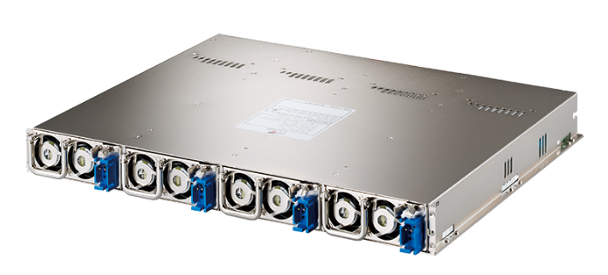
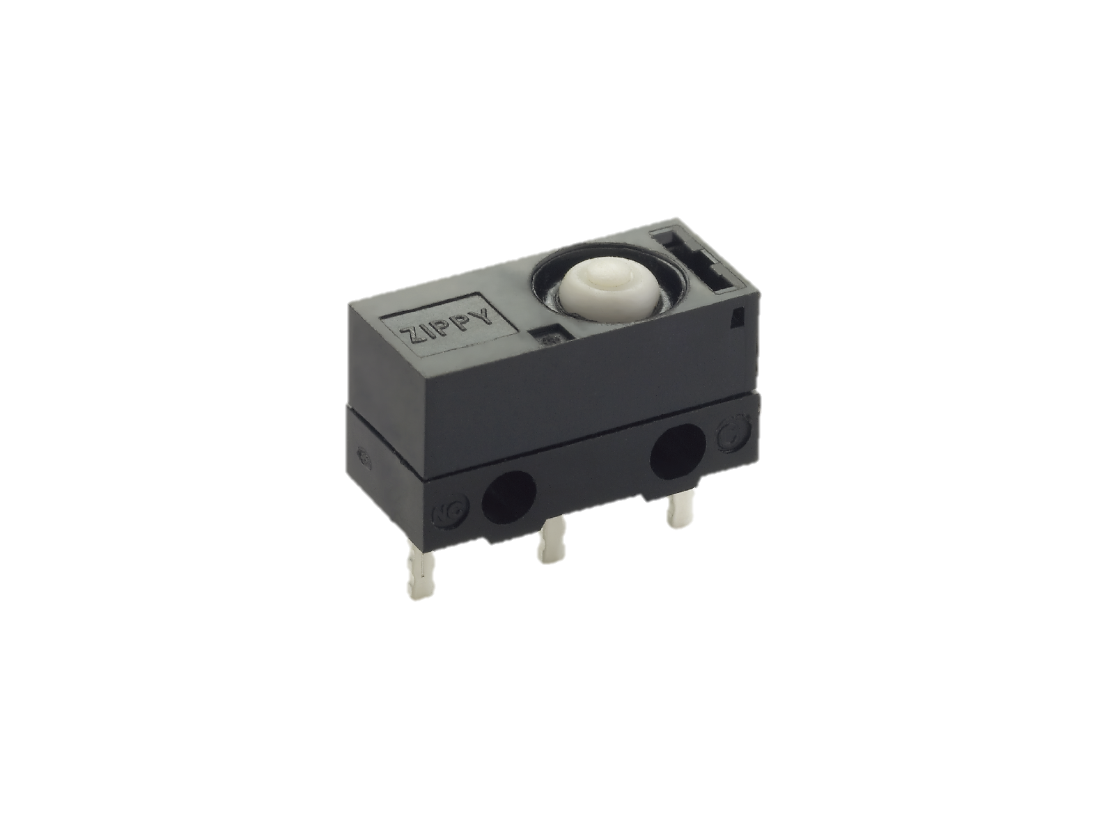
Contribution Ratio for Consolidated Sales Revenue

Slide 8
Q & A

